Slide 1
3D Printing
3D Printing
Barry H Ginsberg, MD, PhD

Slide 2
3D Printing
Printing in Plastic
Printing in Metal
Printing Other Materials

Slide 3
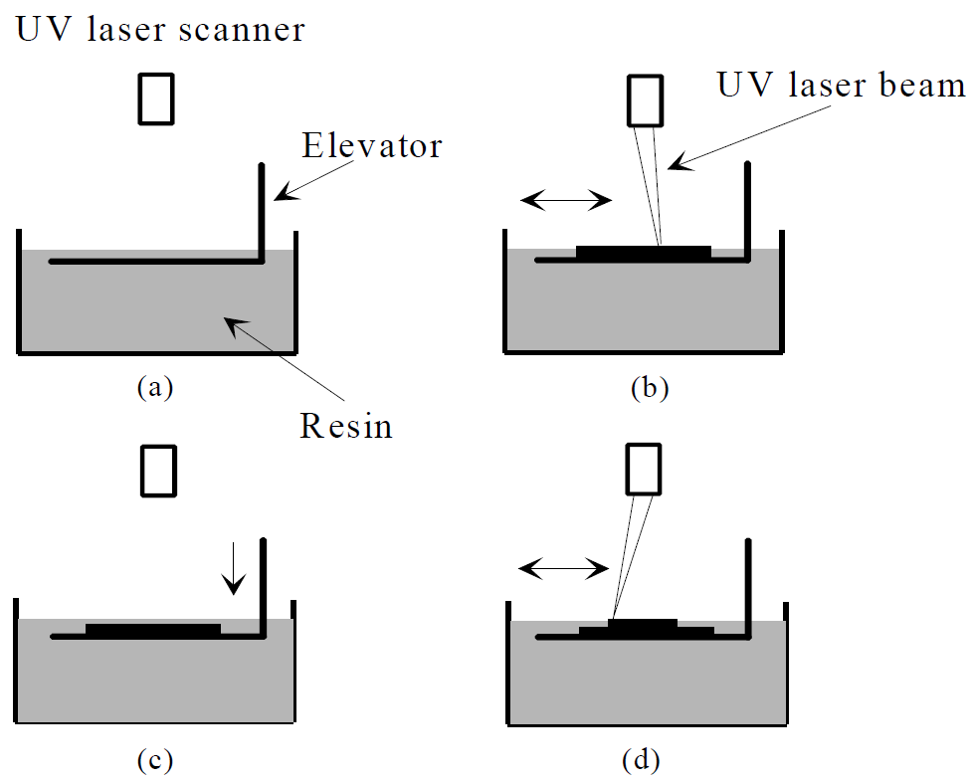
Printing in plastic
Stereolithography
  First 3D printers, 1980’s
  Use light-sensitive liquid
  polymer in Vat (dark)
  Hardens with light
  Platform/Elevator just
  below top of plastic
  Write on with laser
  Lower platform
  Repeat

Slide 4
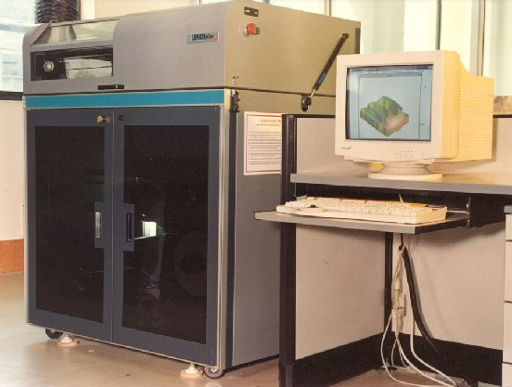
Printing in plastic
Stereolithography
  Machines big and
  expensive ($250K)
  Polymer $800/gal
  (~$100/kg)
  Only limit on printing is
  that layers need to be
  attached
  Generally only used in
  industry

Slide 5
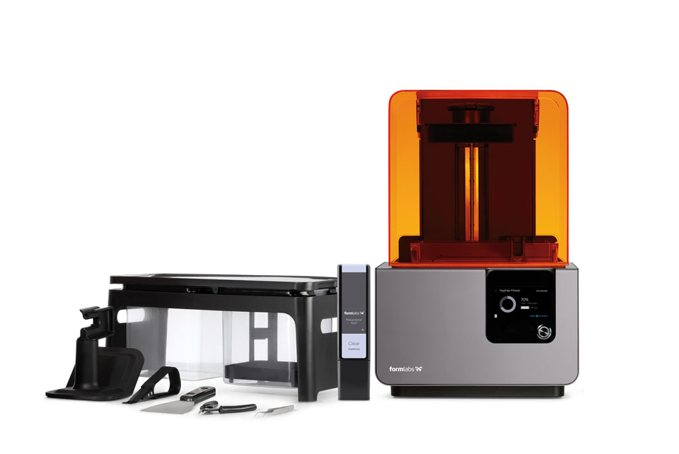
Desktop 3D SLA
Desktop 3D printer
~$3500
Resin $150 vat

Slide 6
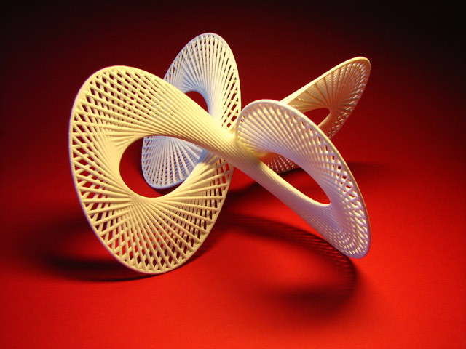
Printing in plastic
Stereolithography
  Early plastics were not
  robust, now better.
  Models to:
  Show consumers
  Show management
  Test for function
  Test for ease of use

Slide 7
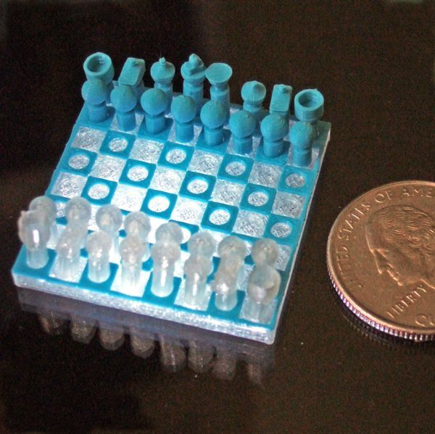
Software, Modeling and language
Need a CAD program, 123D Design
Create the object from primitives
(cubes, rods, freehand, polylines)
Save the CAD file
Export as a STL file
(STereolithography Language)

Slide 8
Software, Modeling and language
STL is a subset of G-code (used for all CAM)
Creates layers
The CAM program
will read the STL file
and adapt
Will add support if
necessary

Slide 9
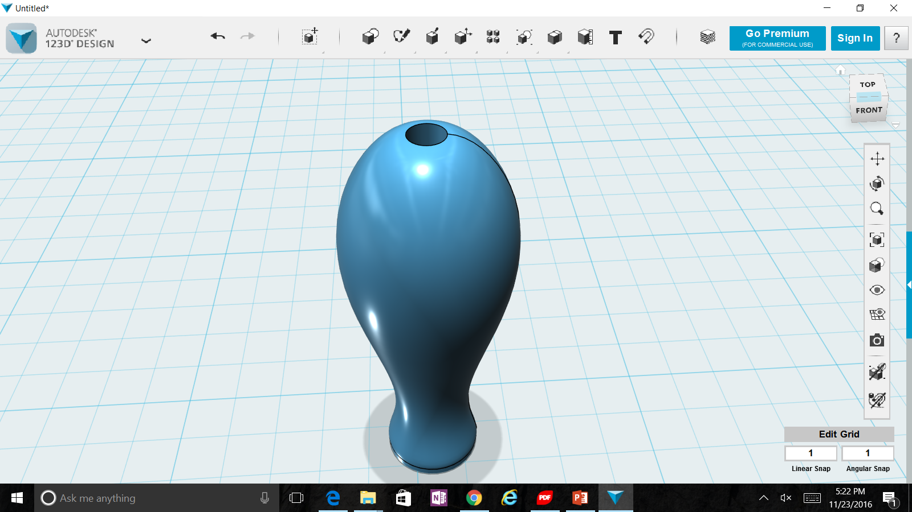
Software, Modeling and language

Slide 10
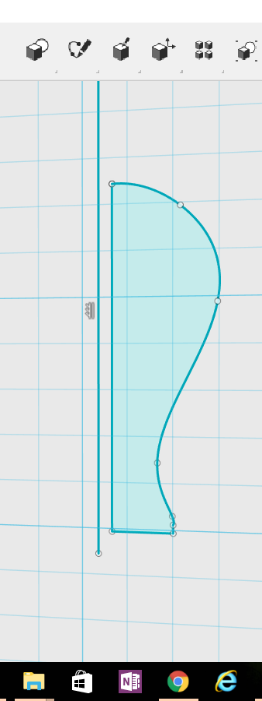
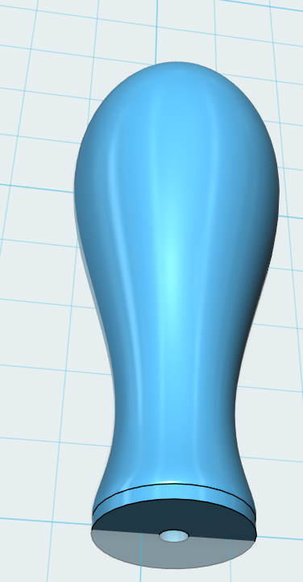
Software, Modeling and language

Slide 11

3D Extruder video

Slide 12
3D Extruders
Heat plastic filament to >200 C (>400 F)
Force through a nozzle to 0.4 mm (0.016 in)
Move back and forth like a plotter, laying down plastic
Raise head 0.2 mm and repeat laying down plastic

Slide 13
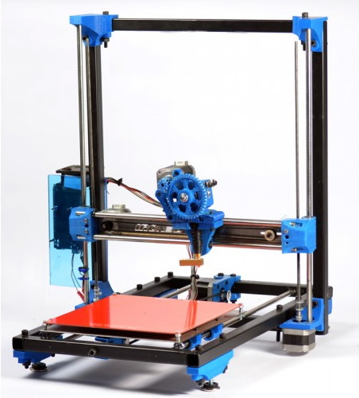
3D Extruders
Print head (x axis)
Elevator (z axis)
Plate (y axis)
Filament
Feeder

Slide 14
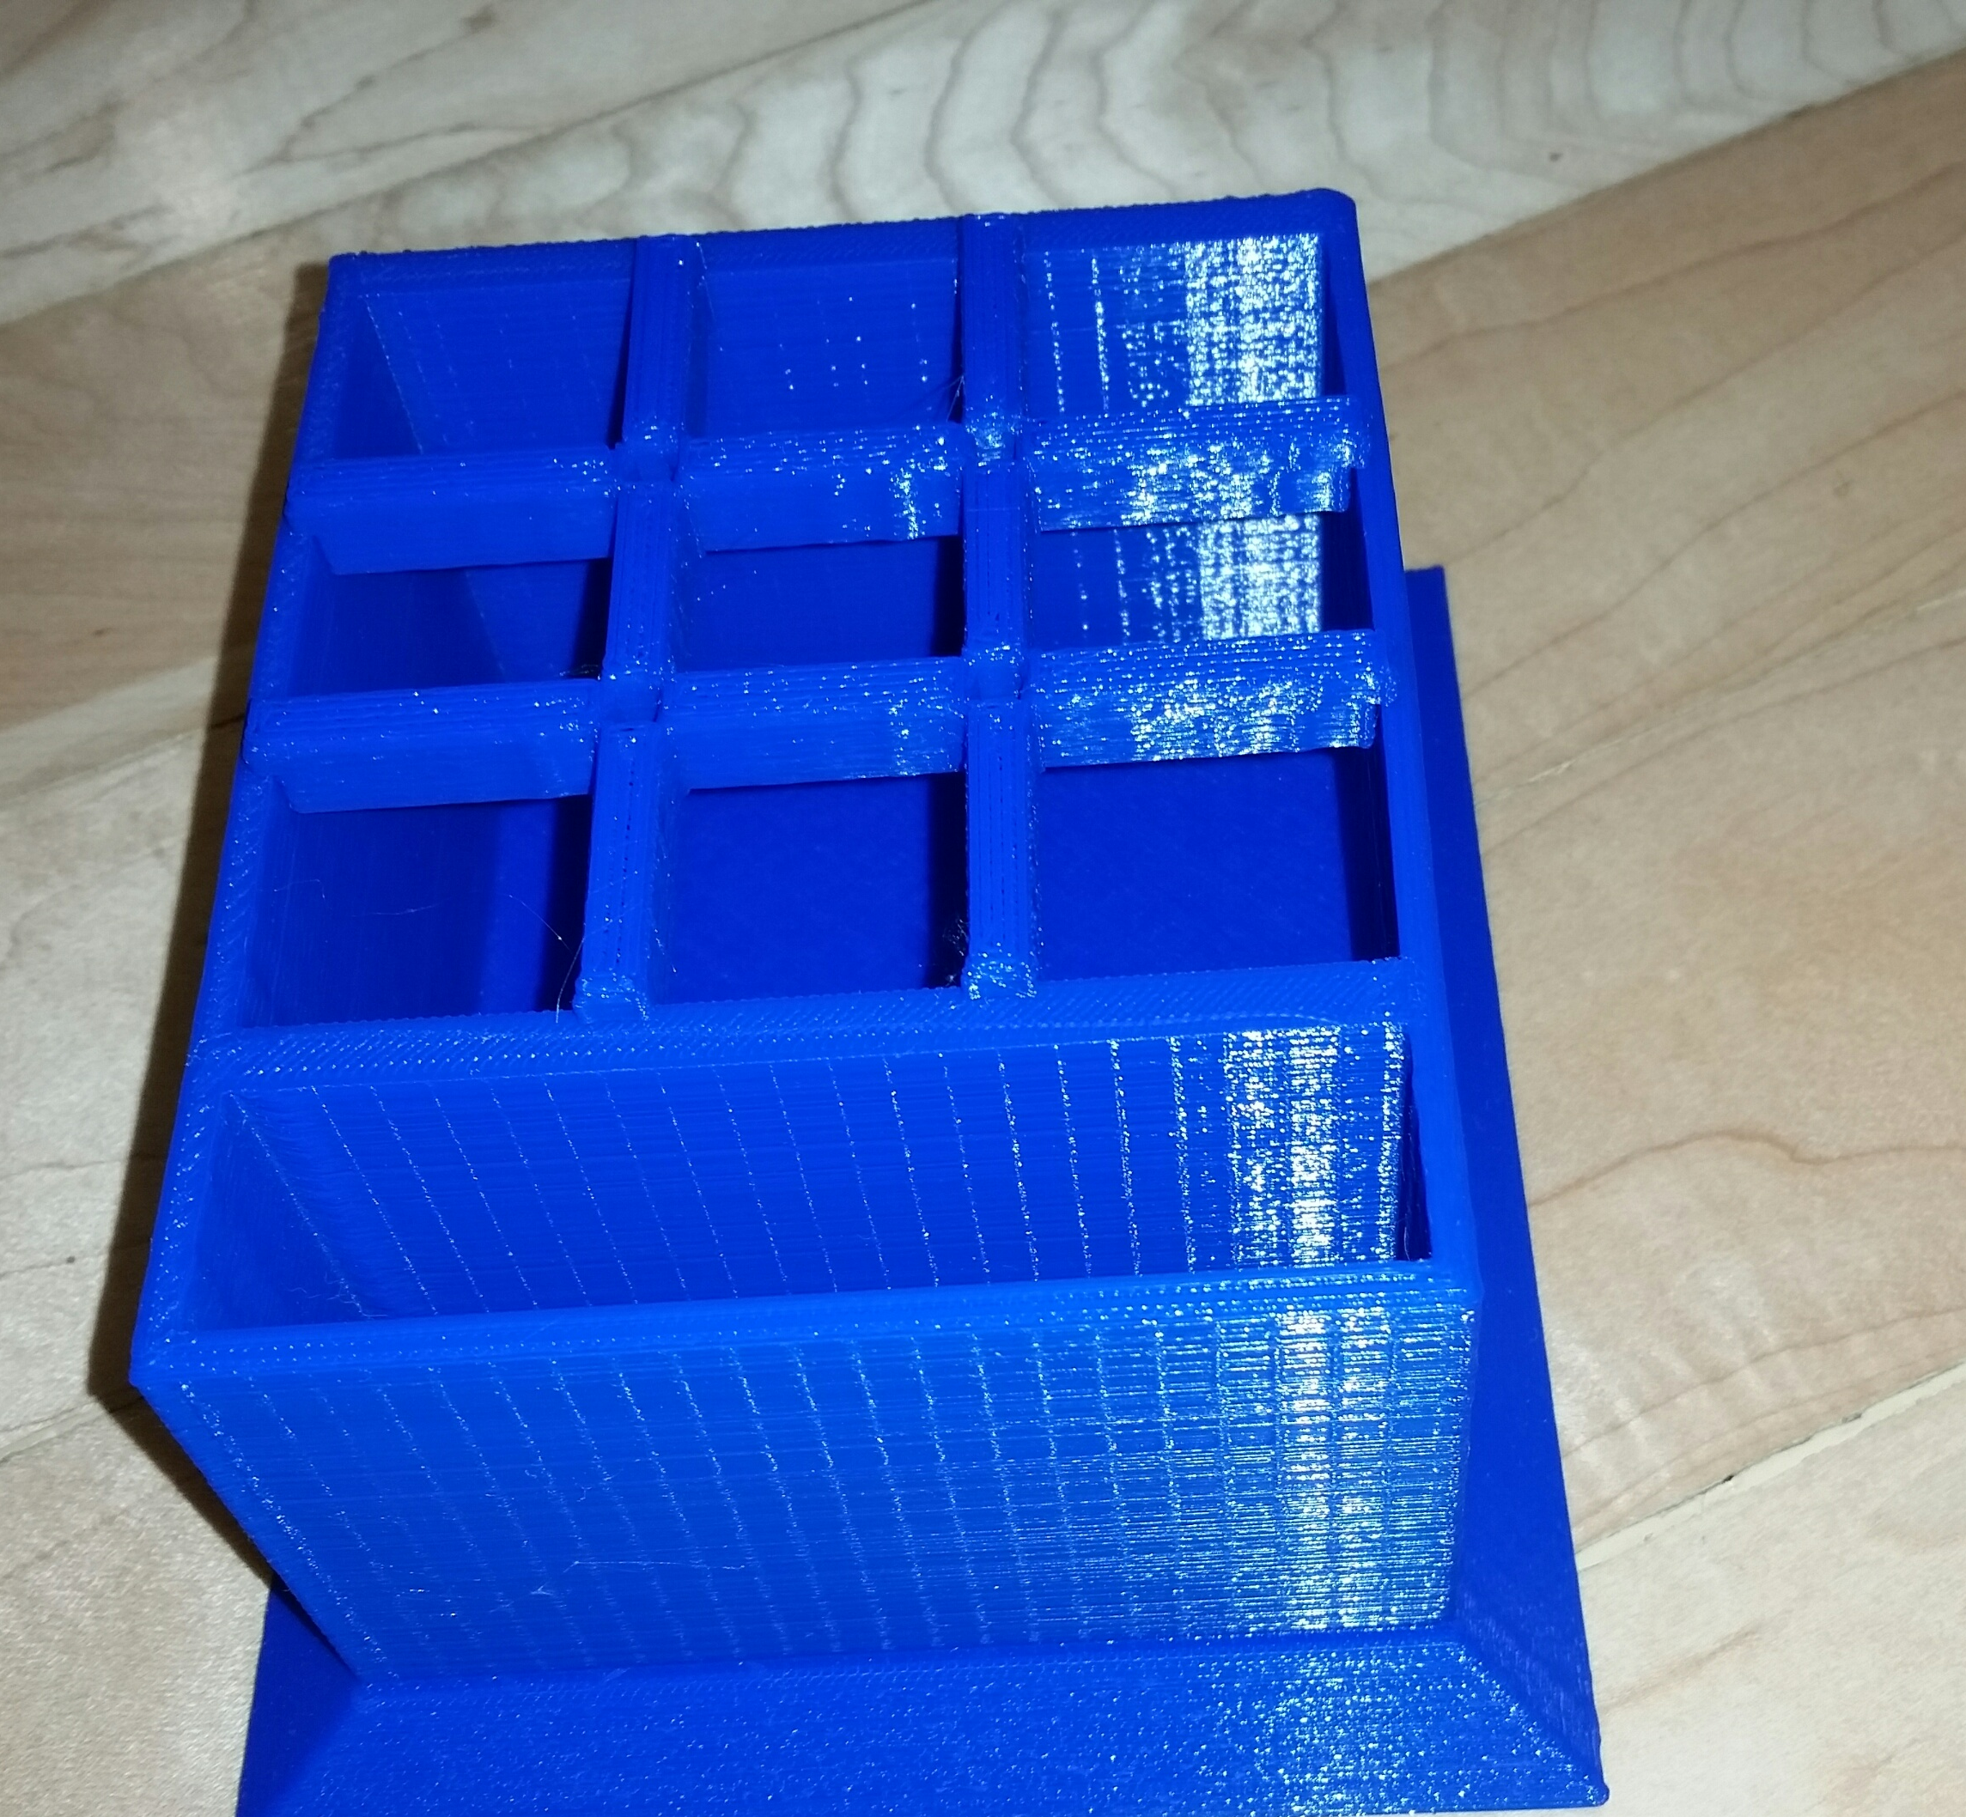
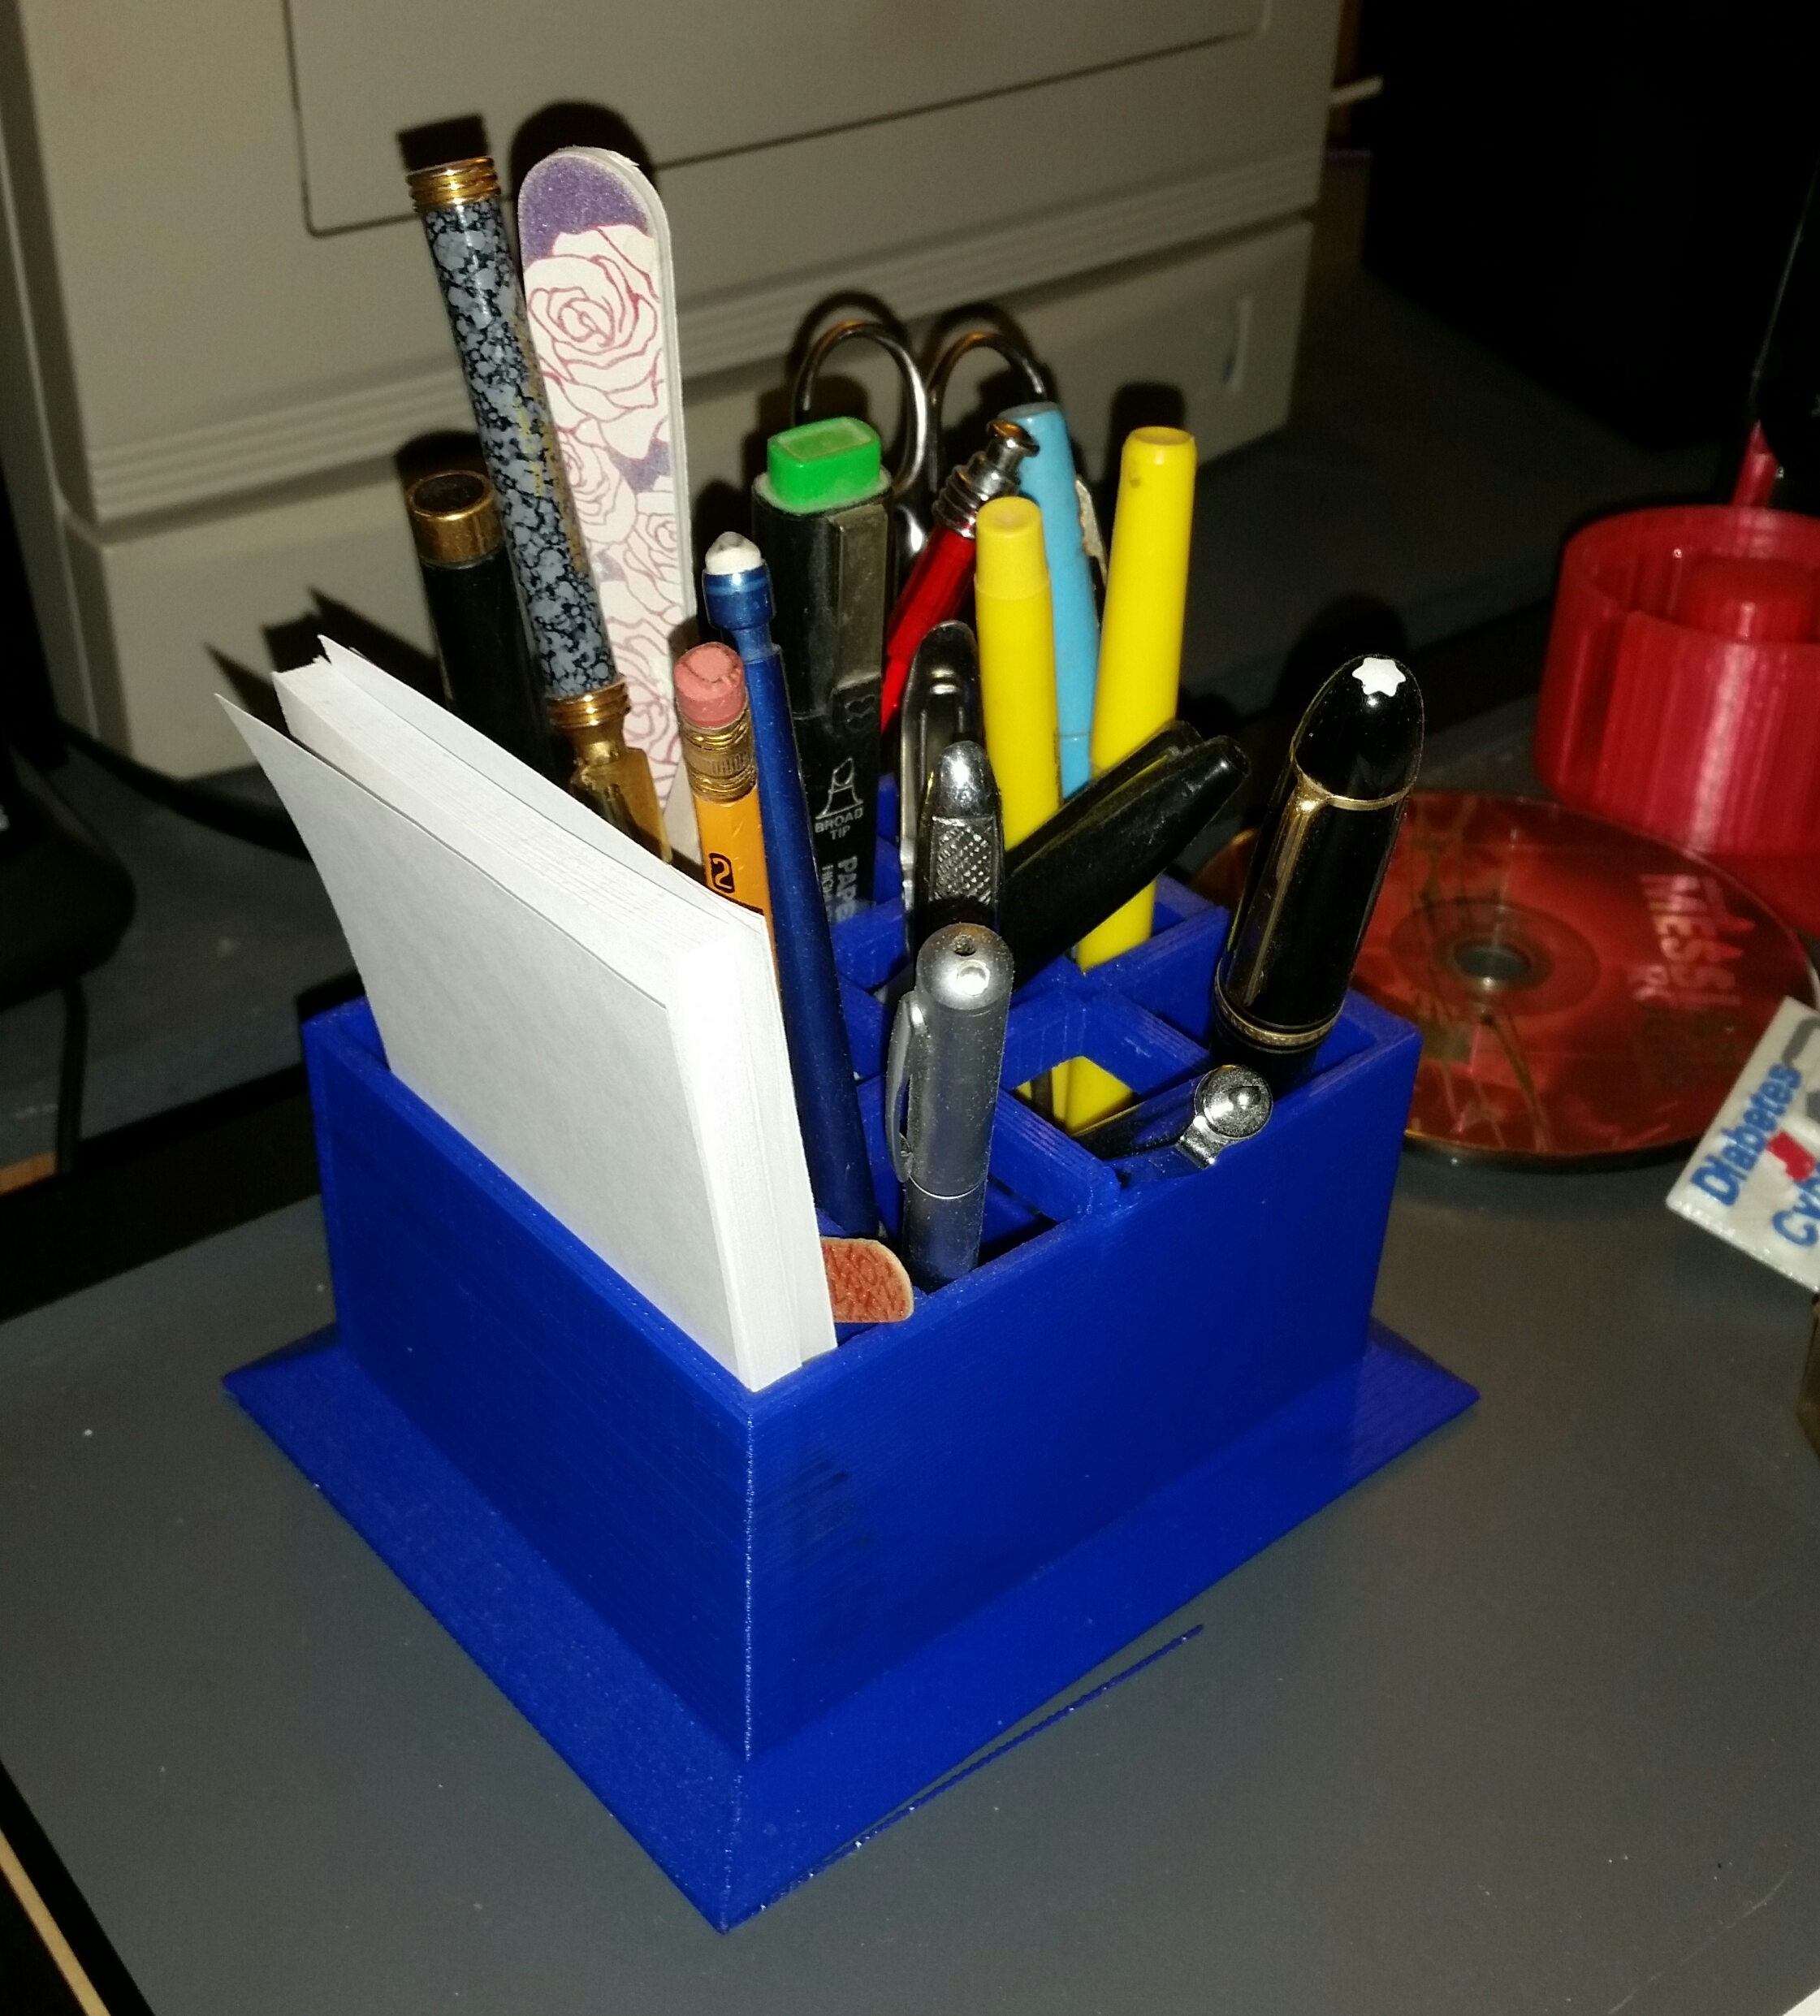
3D Extruders
Slow
Pencil holder about 4 hours
About 25 cents in
plastic

Slide 15
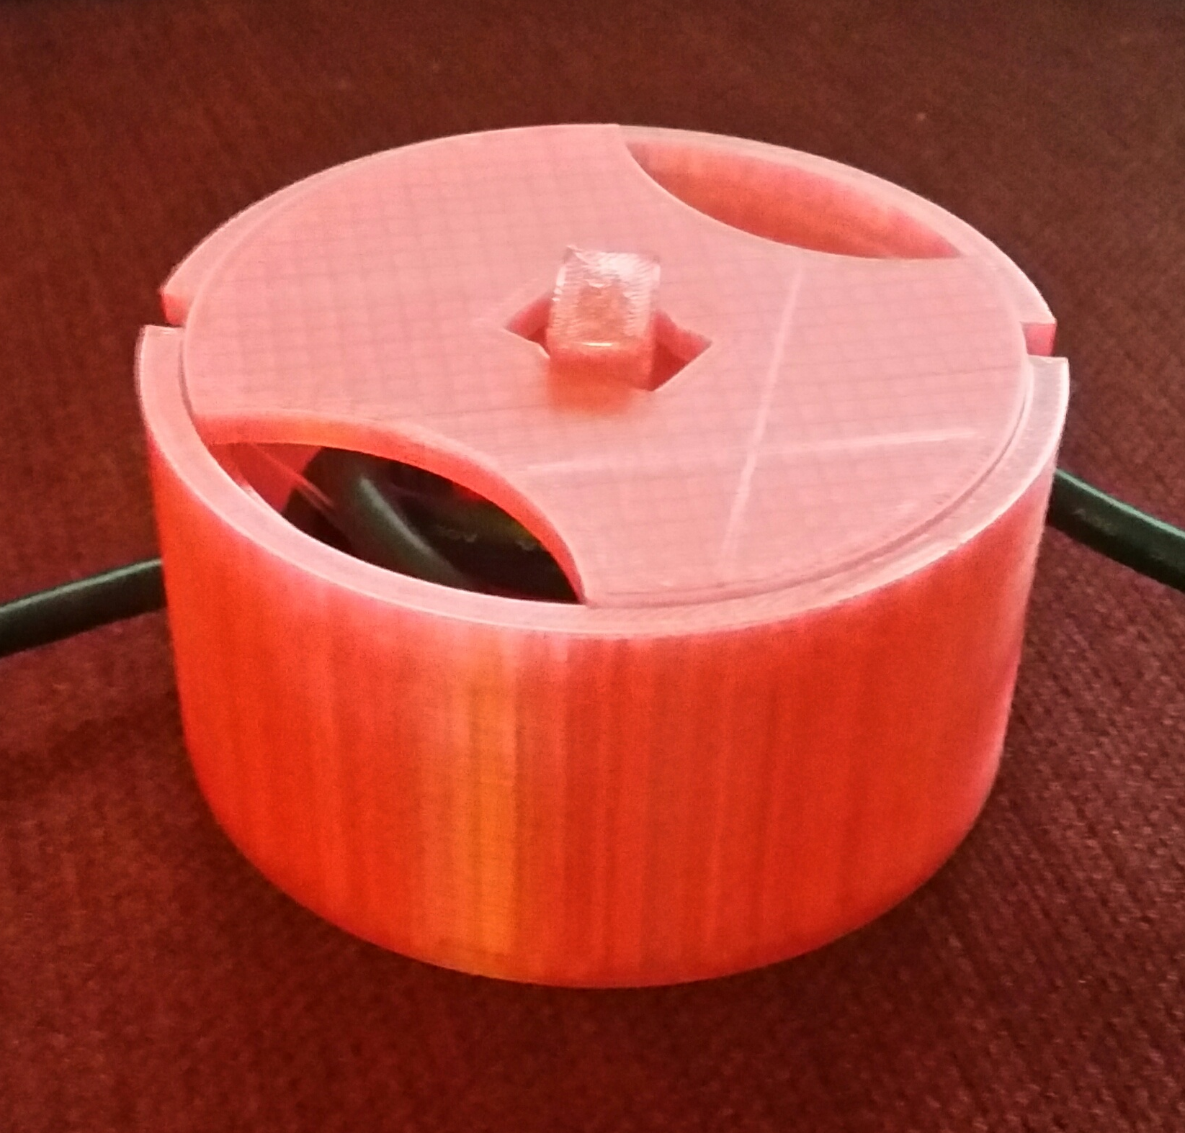
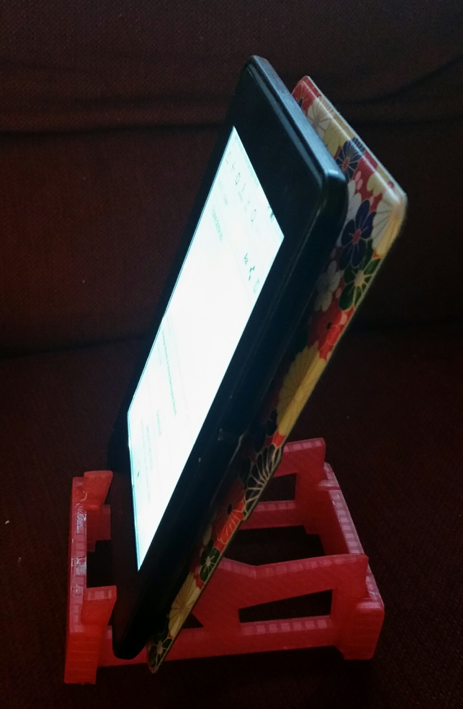
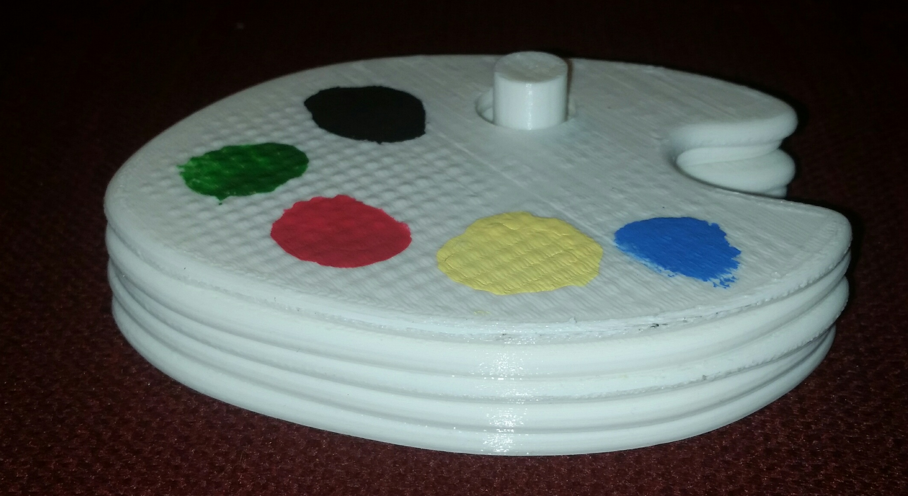
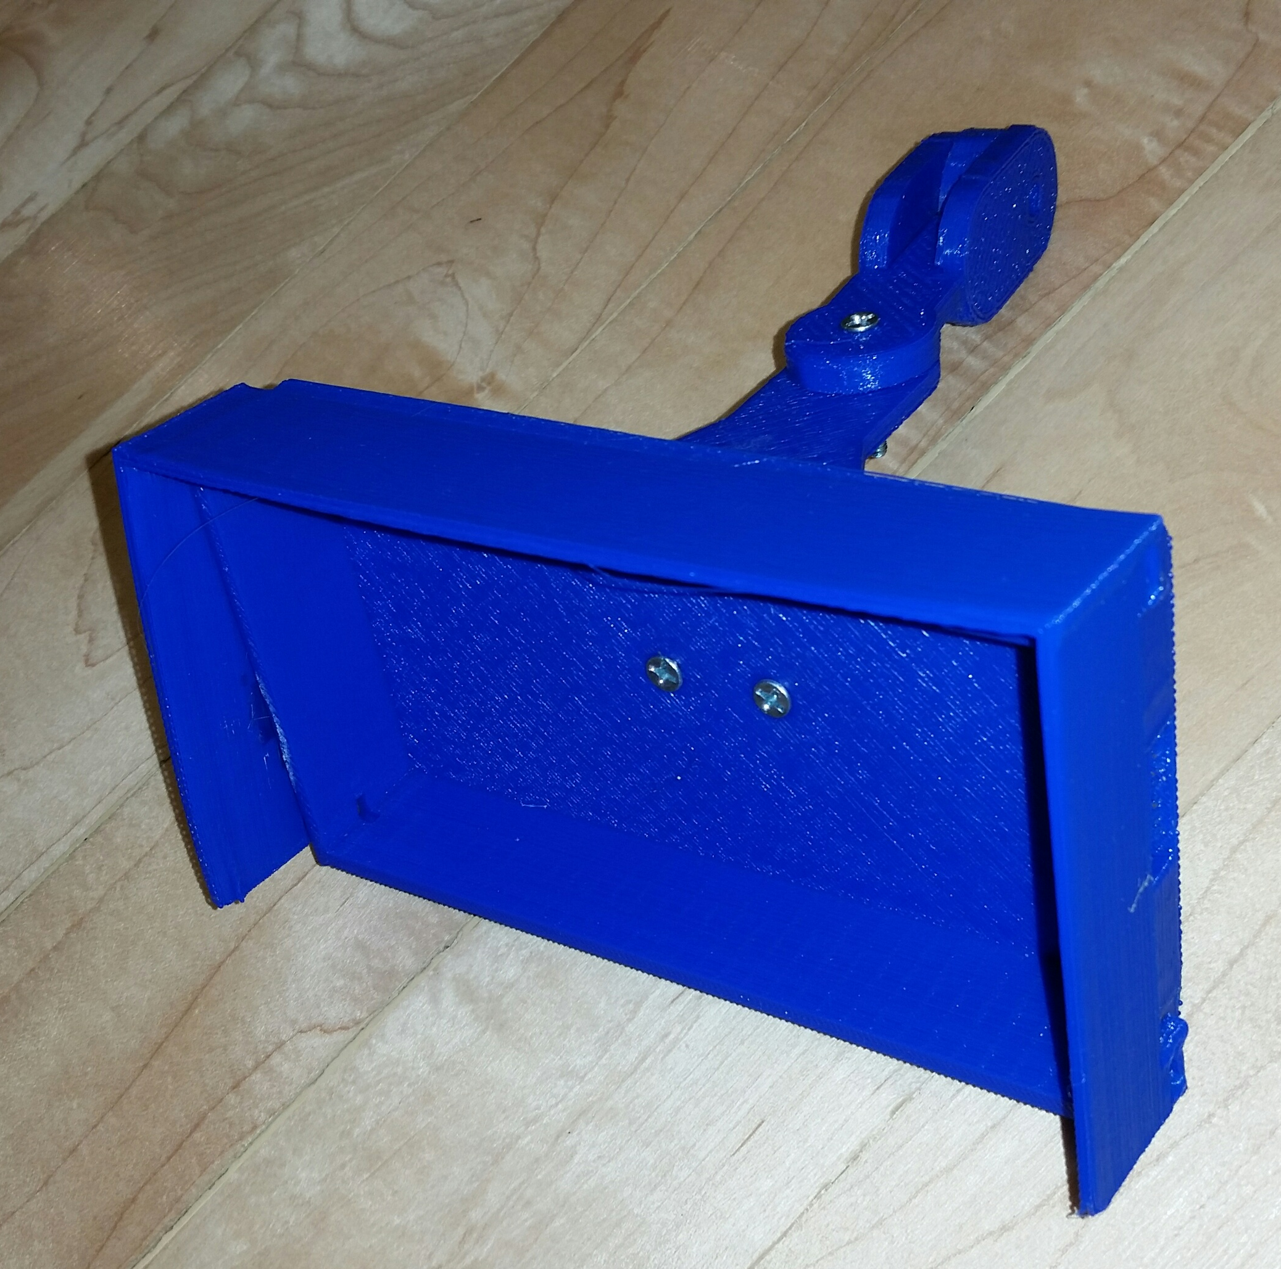
Some of my projects

Slide 16
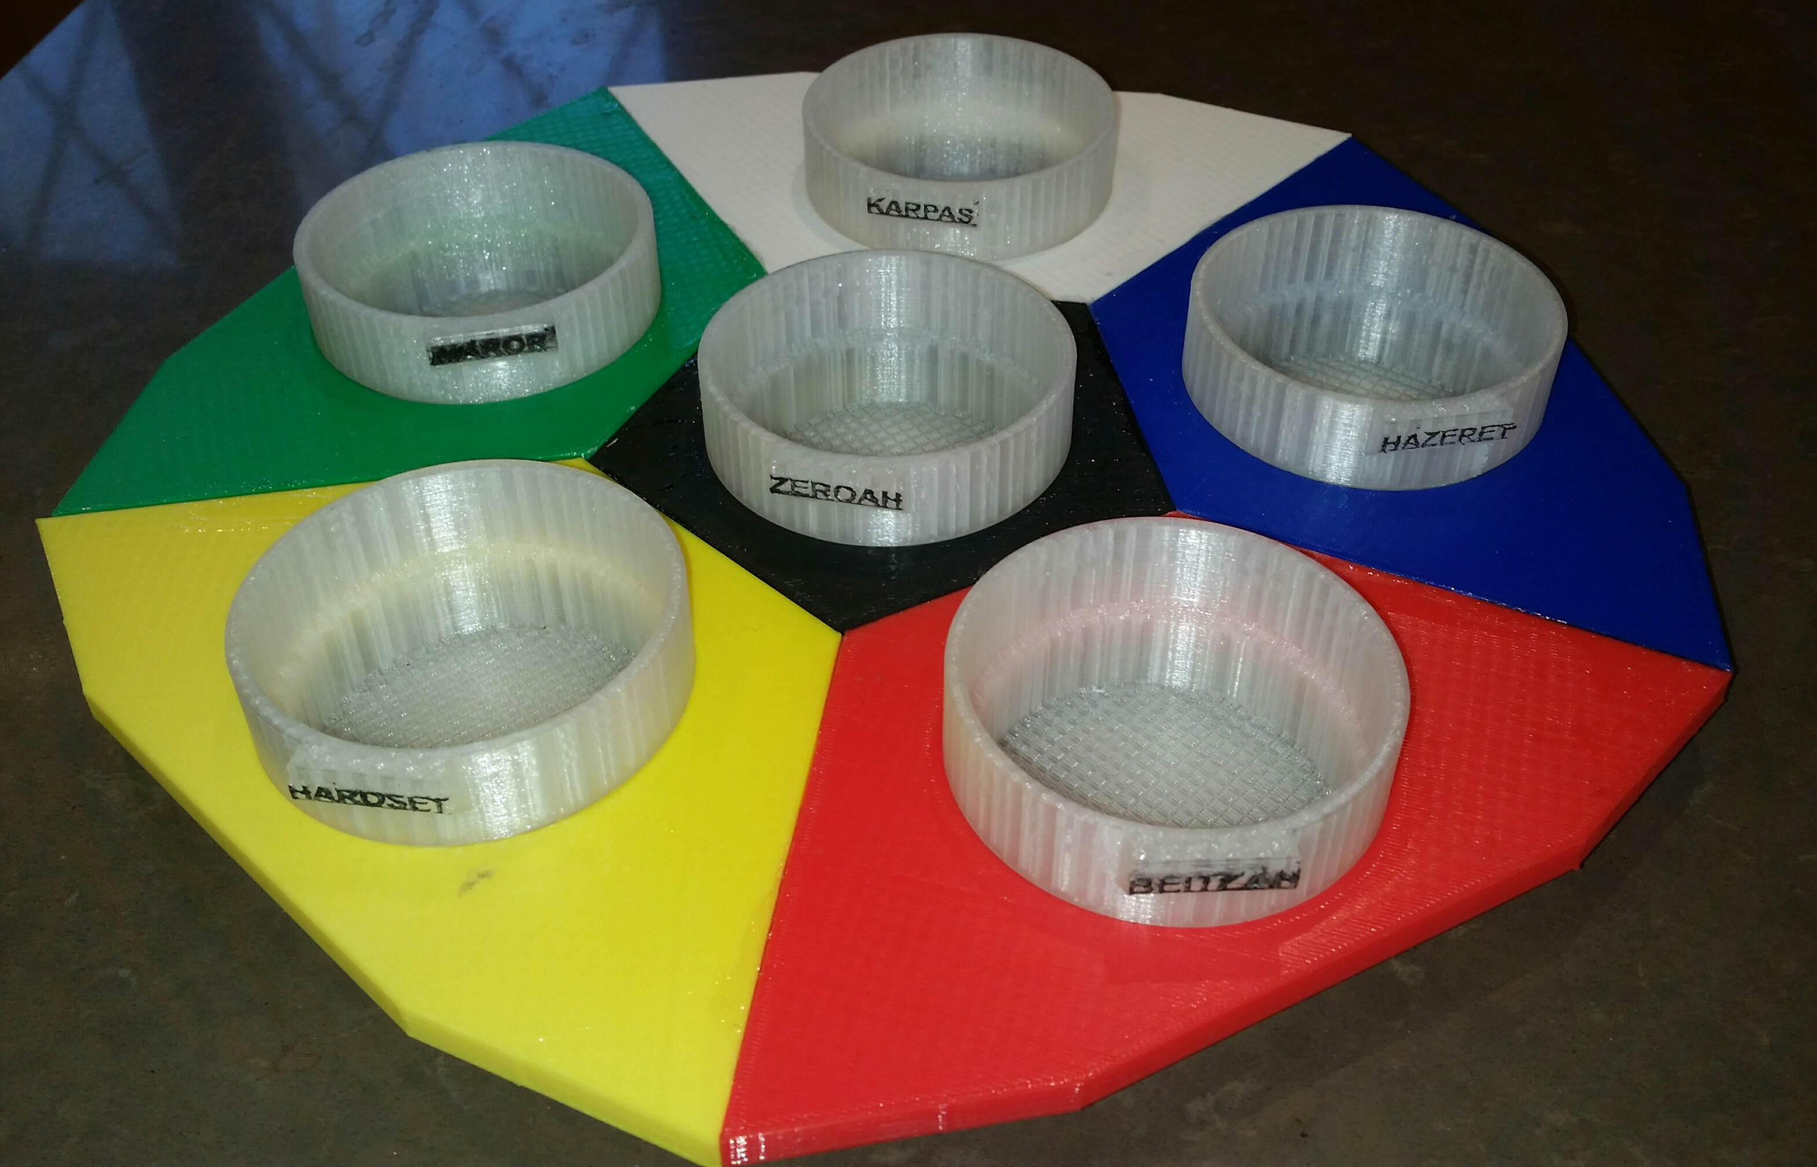
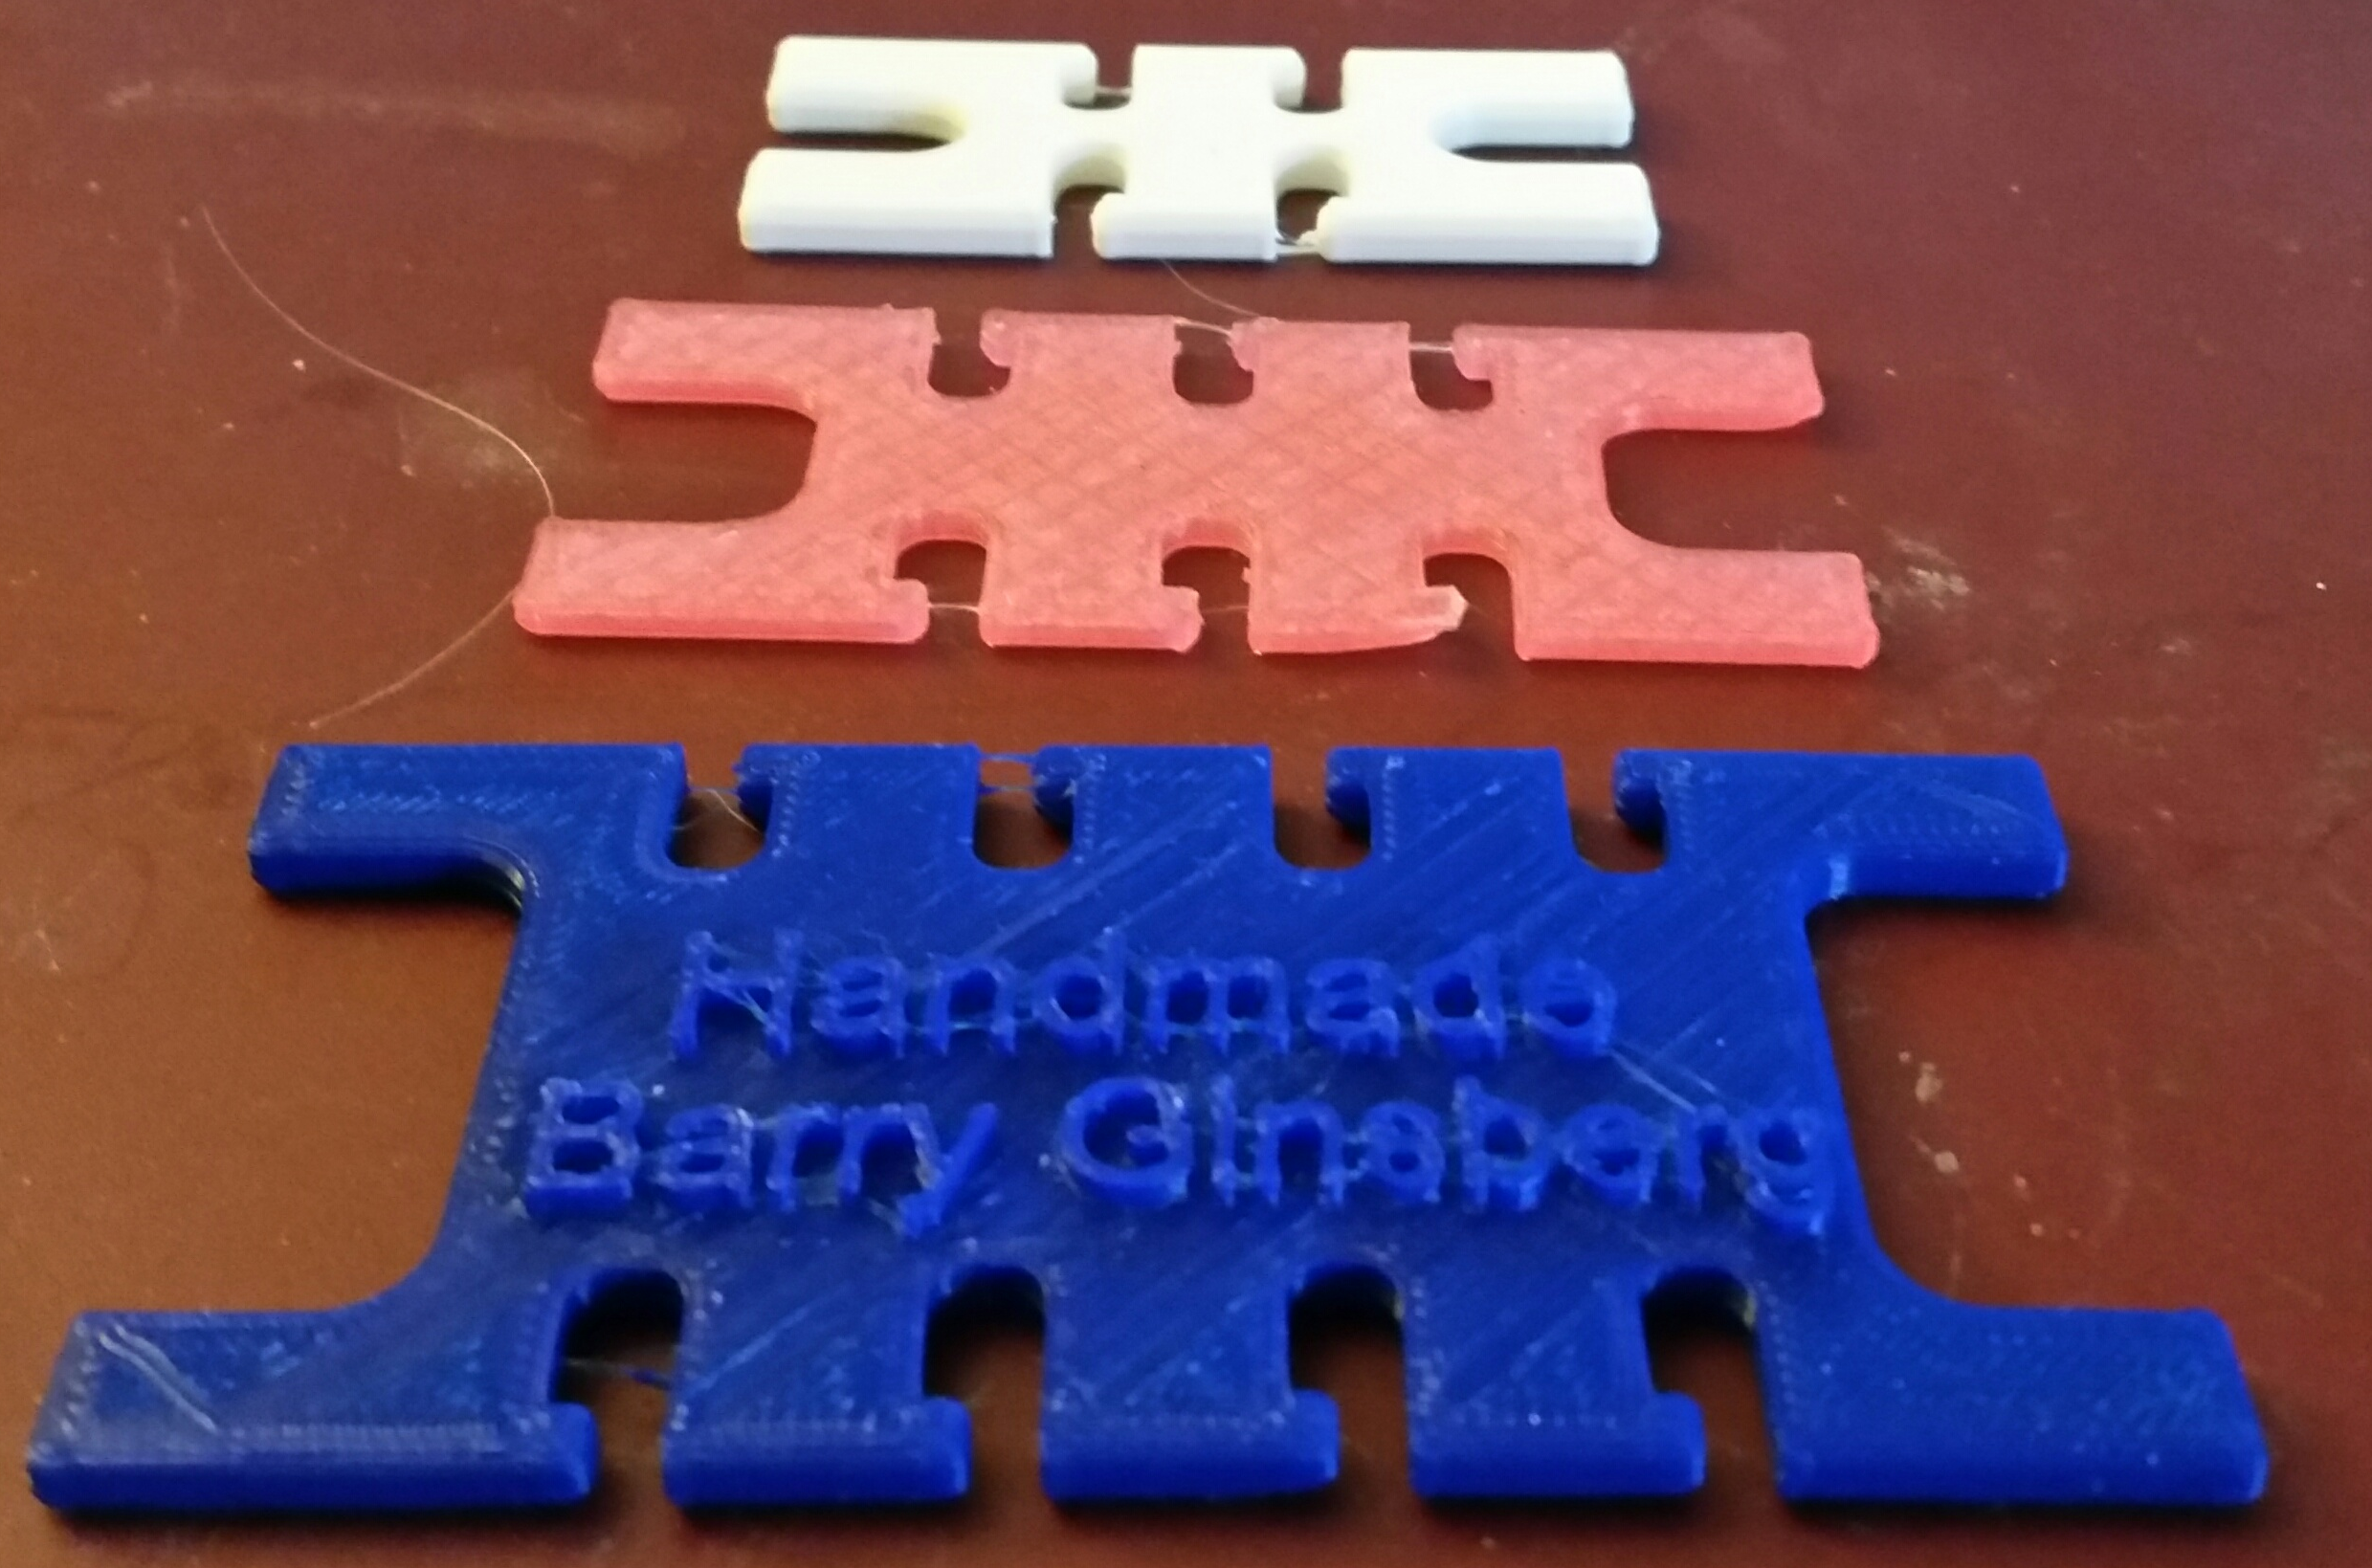
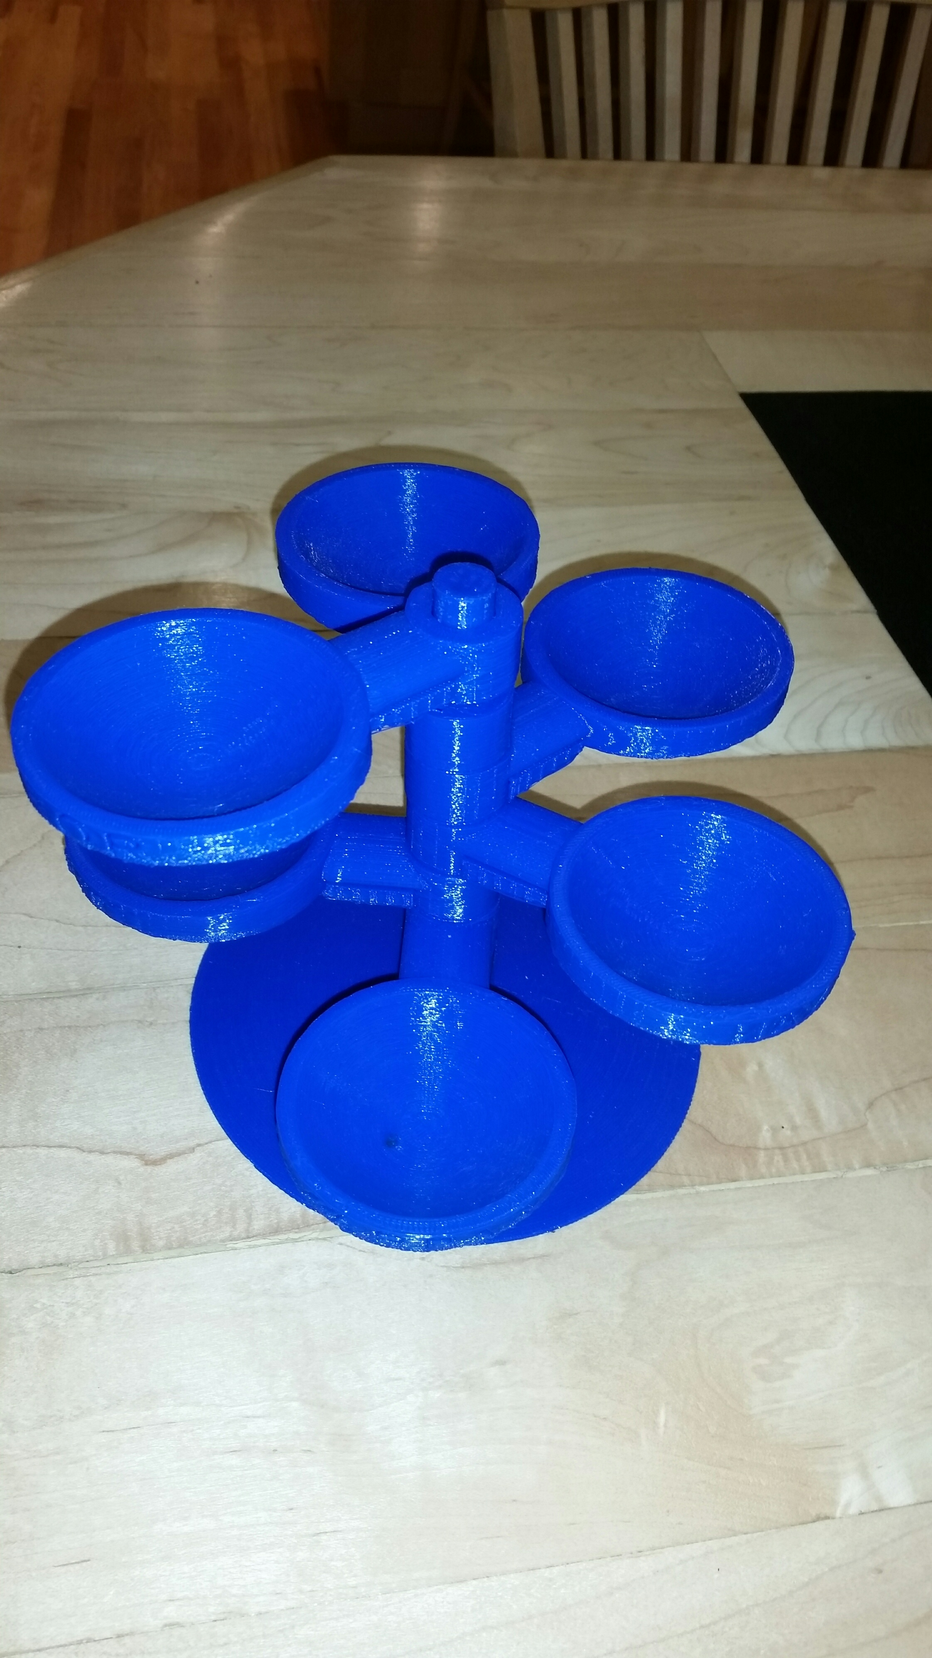
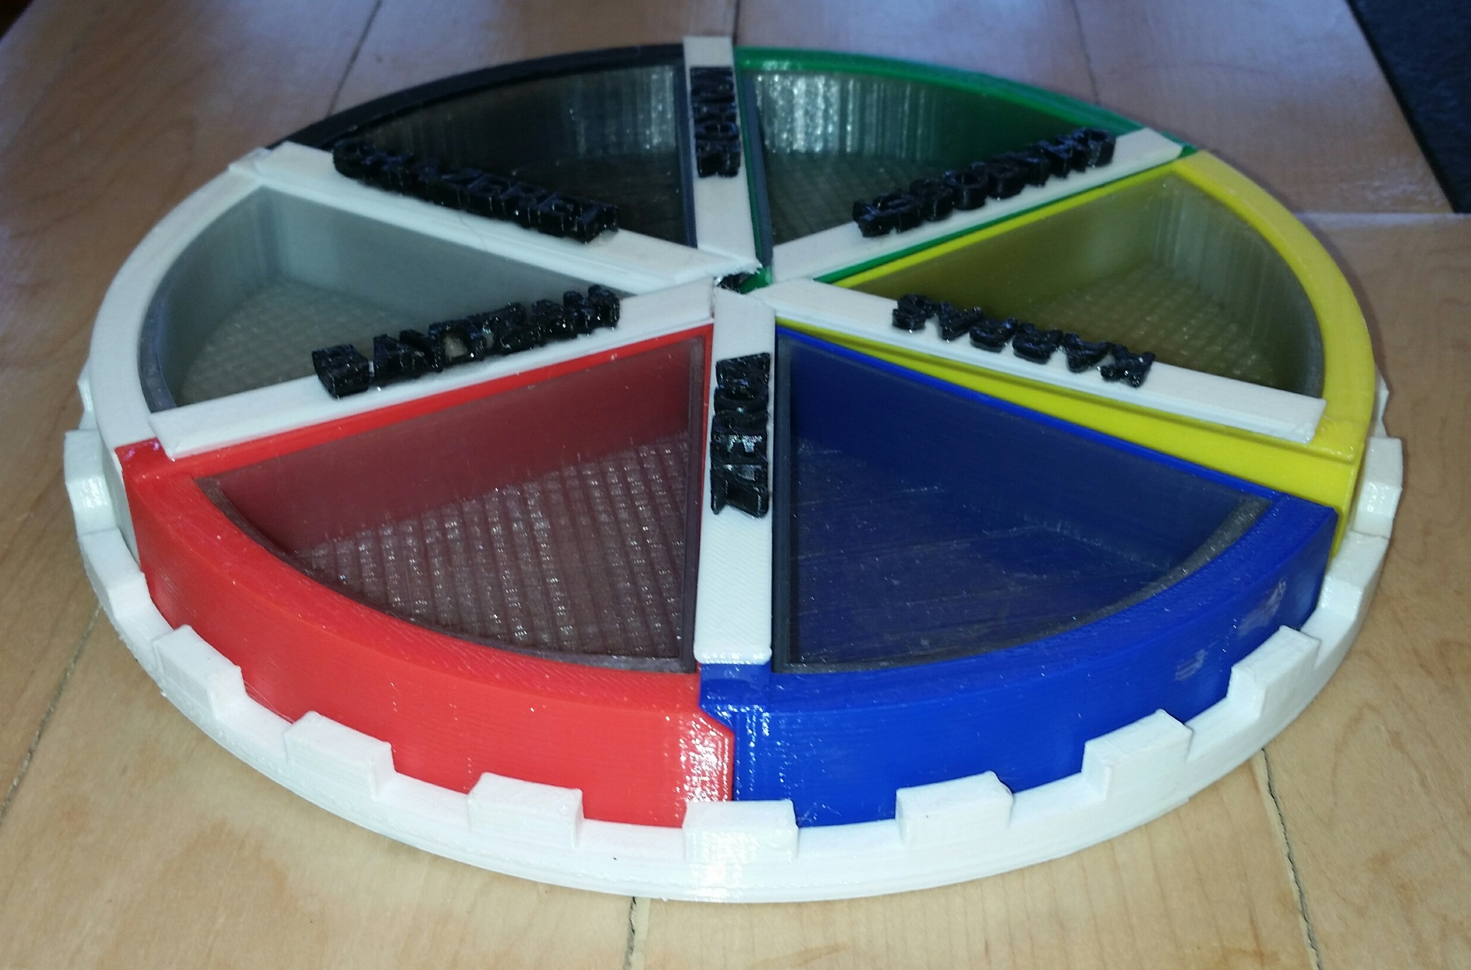
Some more of my Projects

Slide 17
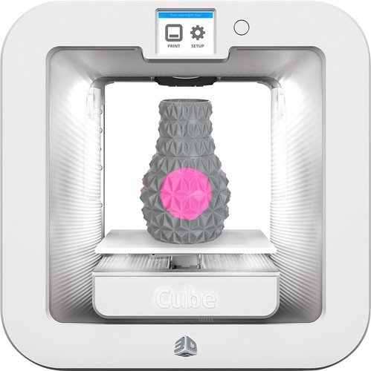
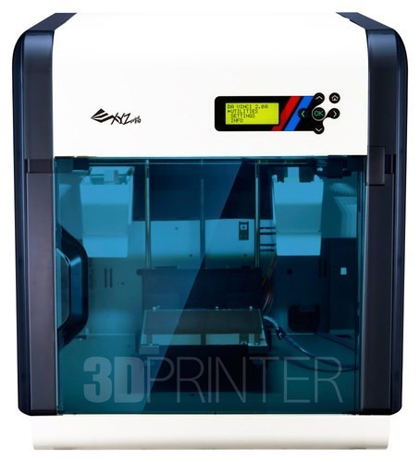
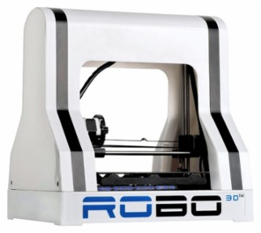
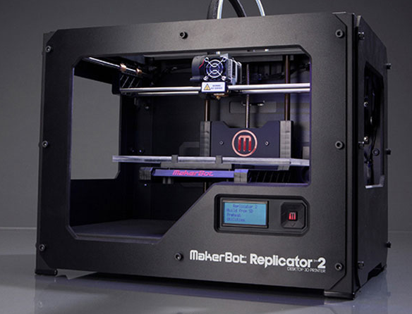
Buying a 3d printer
3D printers are not expensive ($500-2500).
I paid $2500 for my first laser printer ($5000 in today’s dollars)
They don’t required too much computer power (although the CAD may)
But they require frequent repairs that you have to do yourself.
Thus, I think they are not ready for prime time, but hobbyists can have a lot of fun with them
$300
$500
$700
$2500

Slide 18
3D Printing in metal

Slide 19
3D Printing in metal
Sintering metal powder with laser (strong)
Gluing metal powder with print head (needs bronze infusion)
Melting metal powder with laser (very strong)
Metal extrusion (1000-2600 F). Metal powder, laser, base/hotend on gimbals
Metal extrusion, metal nanoparticles, laser, can produce unsupported

Slide 20
3D Printing in metal

Slide 21
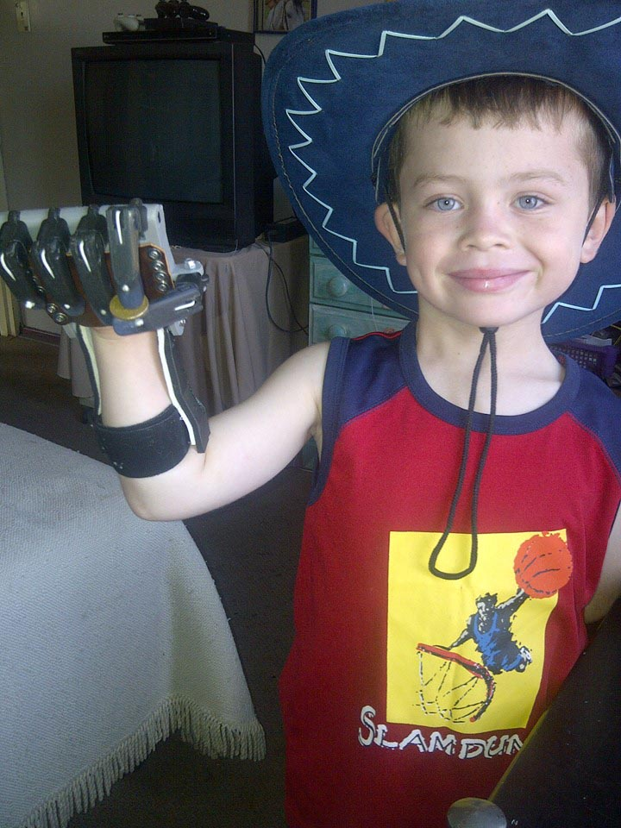
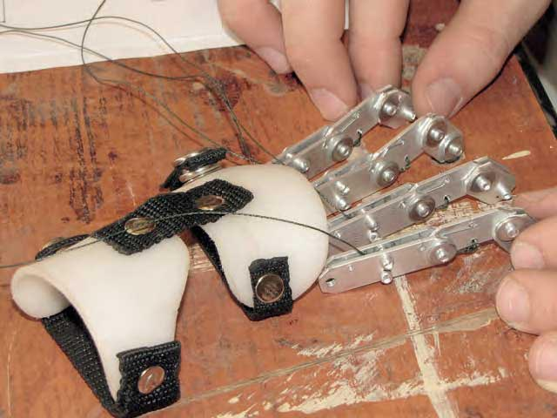
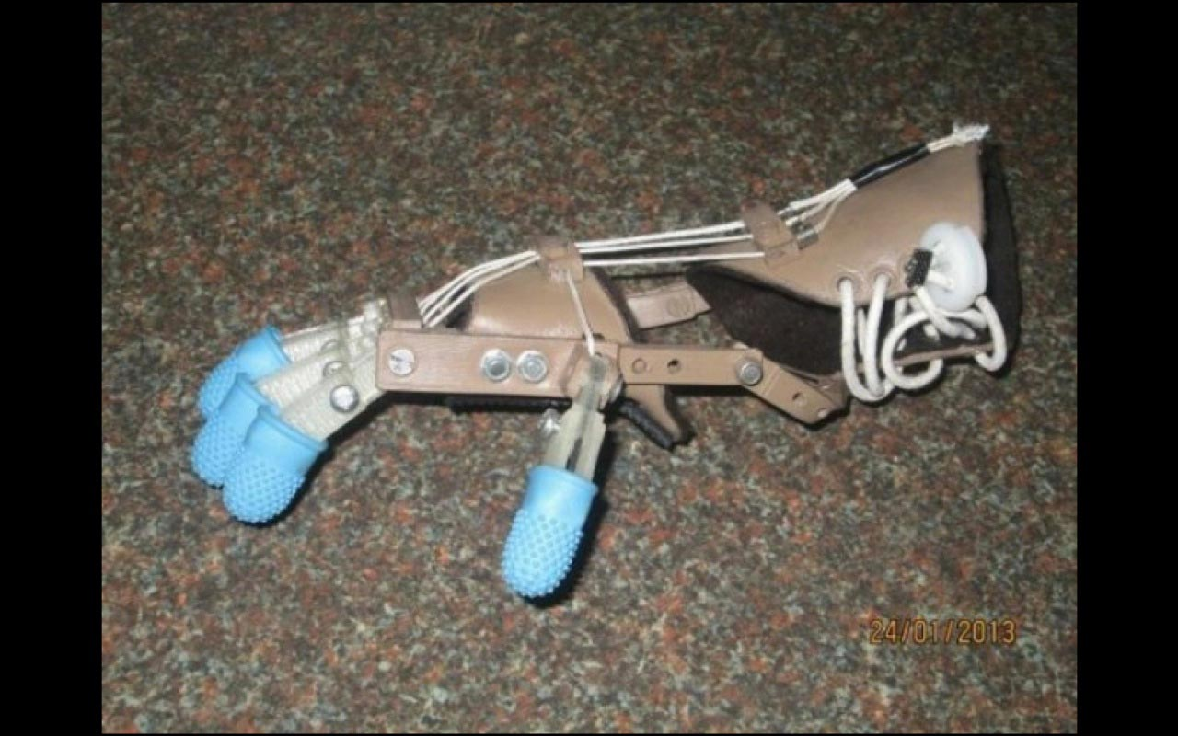
3D Printing, other
Printing a hand

Slide 22
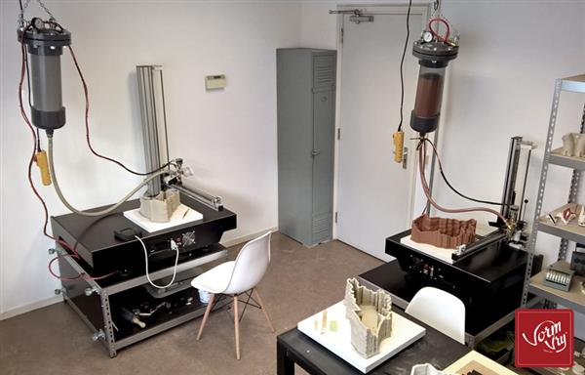
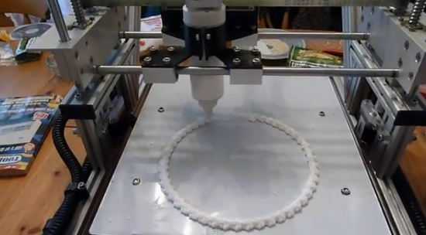
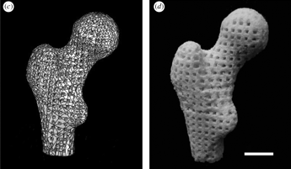
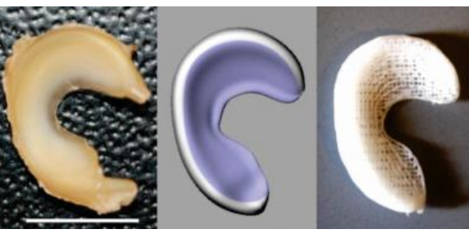
3D printing, other
Ceramics, using clay
Cake decorating
Tissue scaffolding
  Bone
  Cartilage
  Flexible
    Blood vessels
    Gut

Slide 23
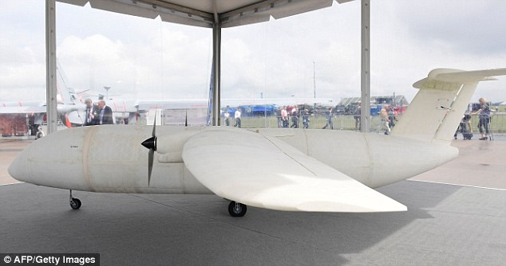
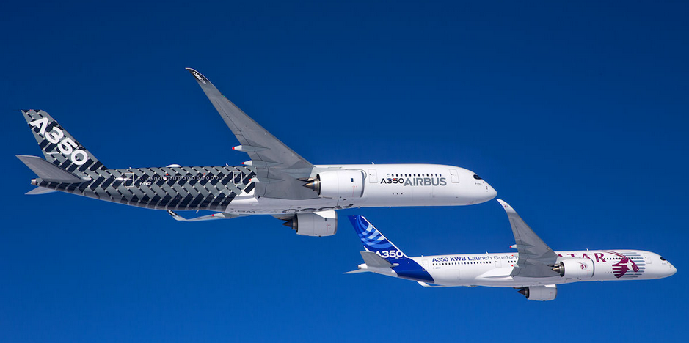
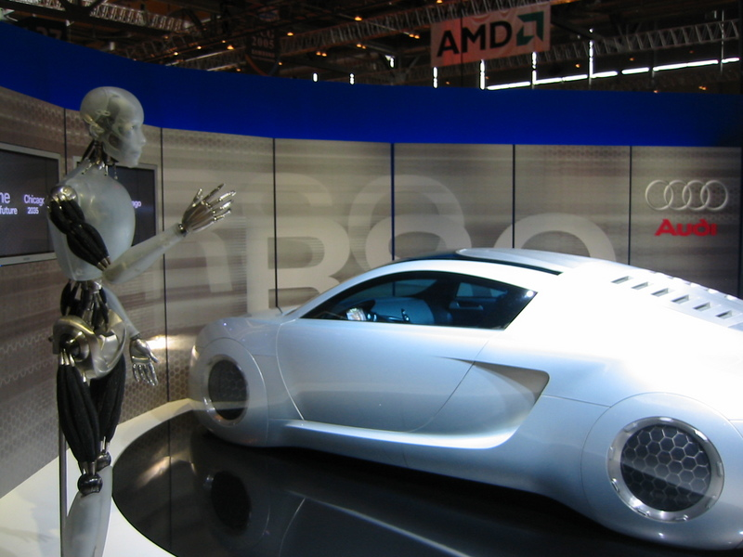
3d Printing, other
Airbus 350 has >1000 3D printed parts
3D printed structures

